Slide 1
Simple (1 filter) Convolution
Simple Pooling
Input volume
C
Input volume
W
Output volume
1
Pooling kernel
Convolutional kernel
C
P
H
K
Output volume

Slide 2
3D Convolution
Input volume
C
W
Output volume
Convolutional kernel
2
c
w
H
K
h

Slide 3
Convolution with padding
Convolution
C
F
C
W
1
W
F
. . .
C
H
K
K

Slide 4
Convolution
C
C
F
F
W
W
C
w
w
F
F
. . .
H
H
h
h
K
K

Slide 5


UNIT STRIDE
NO PADDING
I = 5
O = 4
K = 3
$$⨂$$
=
$$O=I−K+1$$

Slide 6


UNIT STRIDE
ZERO PADDING
9
I = 5
O = 7
K = 3
$$⨂$$
=
$$O=I+2P −K+1$$

Slide 7
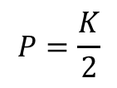
UNIT STRIDE
SAME PADDING
7
I = 5
O = 5
K = 3
$$⨂$$
=
$$P=\frac{K}{2}$$

Slide 8
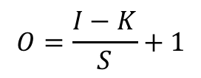
NON-UNIT STRIDE
NO PADDING
I = 5
K = 3
O = 2
$$⨂$$
=
$$O=\frac{I−K}{S}+1$$

Slide 9
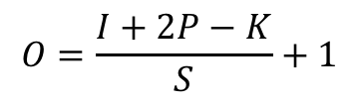
UNIT STRIDE
ZERO PADDING
9
I = 5
O = 4
K = 3
$$⨂$$
=
$$O=\frac{I+2P−K}{S}+1$$

Slide 10
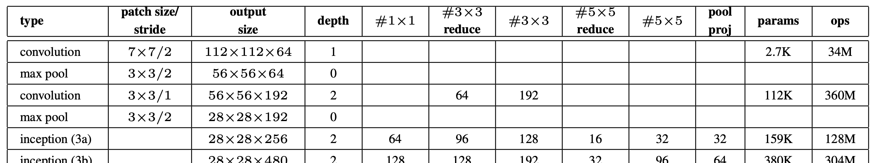
1x1 Convolution

Slide 11
Naïve 5x5
Total multiplications: 28x28x256x5x5x32=160.5M
32
256
32
28
28
. . .
(a)
5
28
256
28
5
5
Optimized
Total multiplications: 28x28x256x1x1x16 + 28x28x16x5x5x32=13.25M
32
16
256
32
28
(b)
. . .
28
16
28
5
28
. . .
16
28
256
28
5
1
5

Slide 12
256
32
16

